Slide 1
Algorithms II

Slide 2
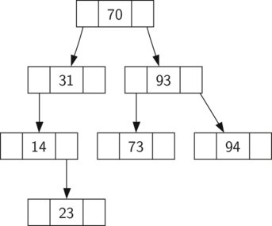
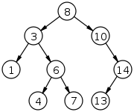
Picking up from last time -- Binary Search Trees
We have a class called TreeNode
TreeNode objects can be organized with a class called BinarySearchTree
BinarySearchTree has methods to place TreeNode objects in relation to each other based on the rules of BSTs
Lets review those rules - which of these aren’t BSTs
6
7
2
8
2
8
1
4
9
1
4
9
3
7

Slide 3
Review - What methods does BST class need
TreeNode has the following attributes
Key, payload, leftchild, rightchild, parent
BST has attributes root and size
What methods does it need? Make a list and share it as a screenshot in the jamboard
This is more important than actually being able to code it
https://jamboard.google.com/d/1wMC5BjrGq3yeqYlNFcpDrByEBUlO58lcuo1pPvysfvE/edit?usp=sharing

Slide 4
put method for Binary Search Tree
This method will check to see if the tree already has a root. If there is not a root then put will create a new TreeNode and install it as the root of the tree. If a root node is already in place then put calls the private, recursive, helper function _put to search the tree according to the following algorithm:
Starting at the root, search the binary tree comparing the new key to the key in the current node.
If the new key < current node, search the left subtree.
If the new key > current node, search the right subtree.
When there is no left (or right) child to search, we have found where the new node should be installed
To add a node to the tree, create a new TreeNode object and insert at the point in the previous step.
Fill in starter code, and then update magic method setitem to call put
def put(self,key,val):
if self.root:
self._put(key,val, self.root)
else:
self.root = TreeNode(key,val)
self.size = self.size + 1
def _put(self,key,val,currentNode):
if key < currentNode.key:
if currentNode.hasLeftChild():
self._put(key,val,currentNode.leftChild)
else:
currentNode.leftChild = TreeNode(key,val,parent=currentNode)
else:
if currentNode.hasRightChild():
self._put(key,val,currentNode.rightChild)
else:
currentNode.rightChild = TreeNode(key,val,parent=currentNode)
Notes:
One important problem with our implementation of insert is that duplicate keys are not handled properly. As our tree is implemented a duplicate key will create a new node with the same key value in the right subtree of the node having the original key. The result of this is that the node with the new key will never be found during a search. A better way to handle the insertion of a duplicate key is for the value associated with the new key to replace the old value. https://colab.research.google.com/drive/1WxsU10GeCpiotTUtIGABdGsGfzTZJEbl?usp=sharing

Slide 5
get method for Binary Search Tree
This method will return the value for a given key
_get is a helper method to do ____
Whats the point of __getitem__ if all it does is call get?
def get(self,key):
if self.root:
res = self._get(key,self.root)
if res:
return res.payload
else:
return None
else:
return None
def _get(self,key,currentNode):
if not currentNode:
return None
elif currentNode.key == key:
return currentNode
elif key < currentNode.key:
return self._get(key,currentNode.leftChild)
else:
return self._get(key,currentNode.rightChild)
def __getitem__(self,key):
return self.get(key)
Notes:
One important problem with our implementation of insert is that duplicate keys are not handled properly. As our tree is implemented a duplicate key will create a new node with the same key value in the right subtree of the node having the original key. The result of this is that the node with the new key will never be found during a search. A better way to handle the insertion of a duplicate key is for the value associated with the new key to replace the old value. We leave fixing this bug as an exercise for you.

Slide 6
Lets add a delete method for BST
f
d
k
Delete a leaf (node with no children)
Delete a node with 1 child
Delete a node with 2 children
g
l
b
def put(self,key,val):
if self.root:
self._put(key,val, self.root)
else:
self.root = TreeNode(key,val)
self.size = self.size + 1
def _put(self,key,val,currentNode):
if key < currentNode.key:
if currentNode.hasLeftChild():
self._put(key,val,currentNode.leftChild)
else:
currentNode.leftChild = TreeNode(key,val,parent=currentNode)
else:
if currentNode.hasRightChild():
self._put(key,val,currentNode.rightChild)
else:
currentNode.rightChild = TreeNode(key,val,parent=currentNode)

Slide 7
Lets add a delete method for BST
f
d
k
def delete(self, key):
if self.size > 1:
node_to_remove = self._get(key, self.root)
if node_to_remove:
self.remove(node_to_remove)
self.size = self.size -1
return
def __delitem__(self, key):
self.delete(key)
g
l
b
e
def put(self,key,val):
if self.root:
self._put(key,val, self.root)
else:
self.root = TreeNode(key,val)
self.size = self.size + 1
def _put(self,key,val,currentNode):
if key < currentNode.key:
if currentNode.hasLeftChild():
self._put(key,val,currentNode.leftChild)
else:
currentNode.leftChild = TreeNode(key,val,parent=currentNode)
else:
if currentNode.hasRightChild():
self._put(key,val,currentNode.rightChild)
else:
currentNode.rightChild = TreeNode(key,val,parent=currentNode)

Slide 8
Lets add a delete method for BST
def delete(self, key):
if self.size > 1:
node_to_remove = self._get(key, self.root)
if node_to_remove:
self.remove(node_to_remove)
self.size = self.size -1
return
elif self.size == 1 and self.root.key == key
self.root = None
self.size = self.size -1
return
raise KeyError(‘Error, key is not in the tree’)
def __delitem__(self, key):
self.delete(key)
f
def put(self,key,val):
if self.root:
self._put(key,val, self.root)
else:
self.root = TreeNode(key,val)
self.size = self.size + 1
def _put(self,key,val,currentNode):
if key < currentNode.key:
if currentNode.hasLeftChild():
self._put(key,val,currentNode.leftChild)
else:
currentNode.leftChild = TreeNode(key,val,parent=currentNode)
else:
if currentNode.hasRightChild():
self._put(key,val,currentNode.rightChild)
else:
currentNode.rightChild = TreeNode(key,val,parent=currentNode)

Slide 9
Bst remove
f
No children
1 child
2 children
def remove(self, node):
if node._is_leaf() and node.parent is not None:
if node == node.parent.left: ###if node is ‘a’
node.parent.left = None ## b.left = none
else: ##if node is c
node.parent.right = None ## b.right = none
elif node.has_one_child()
promoted_node = node.left or node.right
if node.is_left_child(): #if node is g
promoted_node.parent = node.parent #set parent of h as k
node.parent.left = promoted_node #set child of k as h
if node.is_right_child(): #if node is j
promoted_node.parent = node.parent #set parent of i as h
node.parent.right = promoted_node #set h.right as i
d
k
b
e
g
l
h
a
c
j
i

Slide 10
Bst remove
No children
1 child
2 children
def remove(self, node):
if node._is_leaf() and node.parent is not None:
if node == node.parent.left: ###if node is ‘a’
node.parent.left = None ## b.left = none
else: ##if node is c
node.parent.right = None ## b.right = none
elif node.has_one_child()
promoted_node = node.left or node.right
if node.is_left_child(): #if node is g
promoted_node.parent = node.parent #set parent of h as k
node.parent.left = promoted_node #set child of k as h
if node.is_right_child(): #if node is j
promoted_node.parent = node.parent #set parent of i as h
node.parent.right = promoted_node #set h.right as i
else:
node.replace_node_data(promoted_node.key, promoted_node.val, promoted_node.left, promoted_node.right) ###if node is y
y
z

Slide 11
Bst remove 2 children
17
17
35
6
35
5
No children
1 child
2 children
def remove(self, node):
if node._is_leaf() and node.parent is not None:
if node == node.parent.left: ###if node is ‘a’
node.parent.left = None ## b.left = none
else: ##if node is c
node.parent.right = None ## b.right = none
elif node.has_one_child()
promoted_node = node.left or node.right
if node.is_left_child(): #if node is g
promoted_node.parent = node.parent #set parent of h as k
node.parent.left = promoted_node #set child of k as h
if node.is_right_child(): #if node is j
promoted_node.parent = node.parent #set parent of i as h
node.parent.right = promoted_node #set h.right as i
else:
node.replace_node_data(promoted_node.key, promoted_node.val, promoted_node.left, promoted_node.right) ###if node is y
else: ### has 2 children
successor = node.find_sucessor() if successor:
successor.splice_out()
node.key = successor.key
node.val = successor.val
28
53
2
11
28
53
2
11
16
9
16
9
6
8
8

Slide 12
Bst remove 2 children
17
17
35
6
35
5
No children
1 child
2 children
def findSuccessor(self):
succ = None
if self.hasRightChild():
succ = self.rightChild.findMin()
else:
if self.parent:
if self.isLeftChild():
succ = self.parent
else:
self.parent.rightChild = None
succ = self.parent.findSuccessor()
self.parent.rightChild = self
return succ
28
53
2
11
28
53
2
11
16
9
16
9
6
8
8
else: ### has 2 children
successor = node.find_sucessor() if successor:
successor.splice_out()
node.key = successor.key
node.val = successor.val

Slide 13
Bst remove 2 children
17
17
35
6
35
5
No children
1 child
2 children
def findMin(self):
current = self
while current.hasLeftChild():
current = current.leftChild
return current
def spliceOut(self):
if self.isLeaf():
if self.isLeftChild():
self.parent.leftChild = None
else:
self.parent.rightChild = None
elif self.hasAnyChildren():
if self.hasLeftChild():
if self.isLeftChild():
self.parent.leftChild = self.leftChild
else:
self.parent.rightChild = self.leftChild
self.leftChild.parent = self.parent
else:
if self.isLeftChild():
self.parent.leftChild = self.rightChild
else:
self.parent.rightChild = self.rightChild
self.rightChild.parent = self.parent
28
53
2
11
28
53
2
11
16
9
16
9
6
8
8

Slide 14
Depth first search of trees - Review
def get(self,key):
if self.root:
res = self._get(key,self.root)
if res:
return res.payload
else:
return None
else:
return None
def _get(self,key,currentNode):
if not currentNode:
return None
elif currentNode.key == key:
return currentNode
elif key < currentNode.key:
return self._get(key,currentNode.leftChild)
else:
return self._get(key,currentNode.rightChild)
def __getitem__(self,key):
return self.get(key)
f
d
k
Match the code with the output
Inorder: _2_
Postorder: _3_
Preorder: _1_
b
e
g
l
h
a
c
j
i
fdbacekghjil | (2) abcdefhijgkl | (3) acbedijhglkf
def inorder(node): if node: inorder(node.get('left')) print(node['val']) inorder(node.get('right')) | def postorder(node): if node: postorder(node.get('left')) postorder(node.get('right')) print(node['val']) | def preorder(node): if node: print(node['val']) preorder(node.get('left')) preorder(node.get('right'))

Slide 15
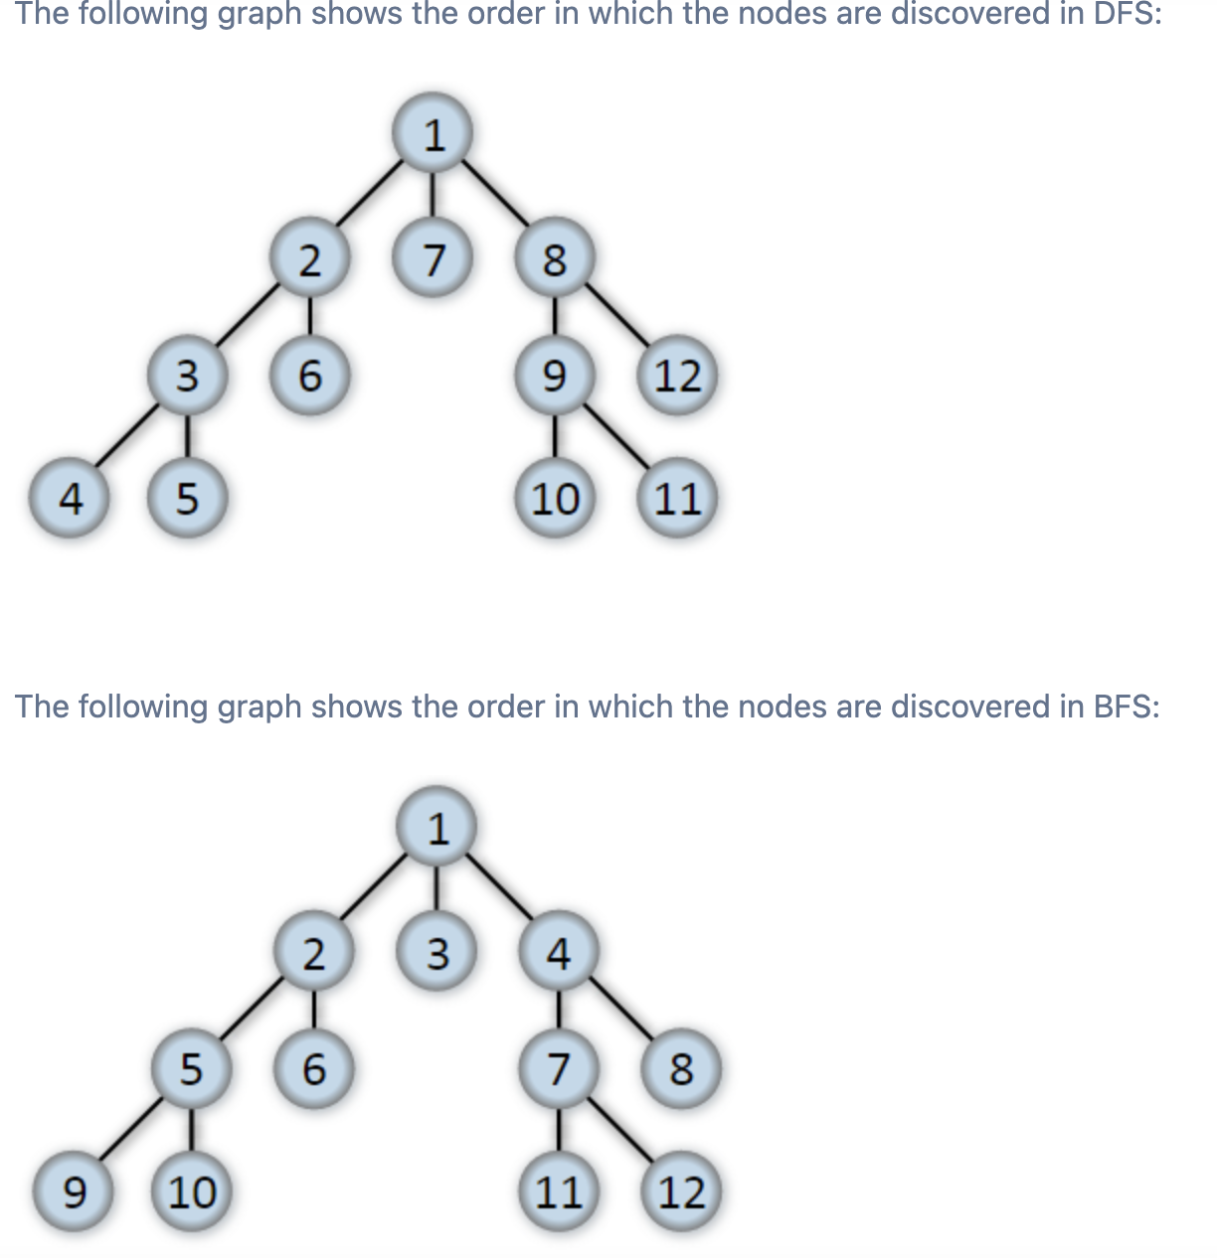
DFS vs BFS
DFS Advantages | BFS Advantages
faster | slower
less memory | More memory

Slide 16
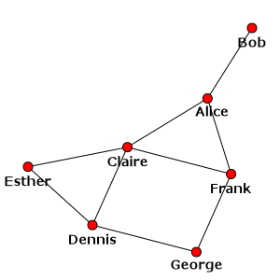
Breadth First Search Graphs
Let’s write pseudocode
https://jamboard.google.com/d/10965PaoICdWCUEkrDFDadv479ZFY77cnNlvnn5wfa9A/edit?usp=sharing
Pick Node X
Add neighbors of X to a queue Z
Add X to a list of explored nodes W
Repeat 1-3 from queue Z
Explored = [Dennis, Esther, Claire, George, Frank, Bob, Alice]
Let’s implement with code https://colab.research.google.com/drive/1MwqXX-NX6fPXtpQosIQRXntsYsKgtBPW?usp=sharing

Slide 17
Depth First Search Graphs
Let’s write pseudocode
https://jamboard.google.com/d/10965PaoICdWCUEkrDFDadv479ZFY77cnNlvnn5wfa9A/edit?usp=sharing
Pick Node X
Add neighbors of X to a stack Z
Add X to a list of explored nodes W
Repeat 1-3 from stack Z
Visited= [Esther, Dennis, George, Frank, Claire, Alice, Bob]
Let’s implement with code https://colab.research.google.com/drive/1MwqXX-NX6fPXtpQosIQRXntsYsKgtBPW?usp=sharing

